Slide 1
A protein – protein docking game for science and education
Richard Sessions UoB

Slide 2
Genetic information (DNA) is the cell’s blueprint for making proteins
Proteins are nanoscale objects with (usually) well defined 3D structures
Proteins
Ubiquitous - present in all organisms
The main functional elements of the cell.
Catalysts
Transporters
Transducers
Communicators

Slide 3
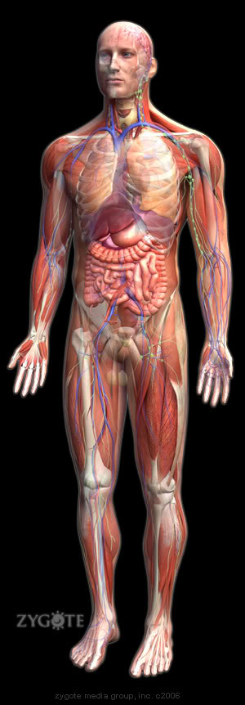

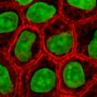

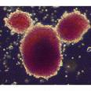
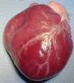
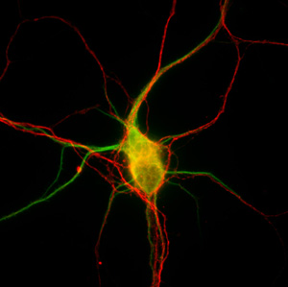
Components of an organism
Organs in the human body ~ 80
Cells in adult human ~ 10¹⁴
Stained epithelial cells
Undifferentiated
stem cell
Stained neuronal cells

Slide 4
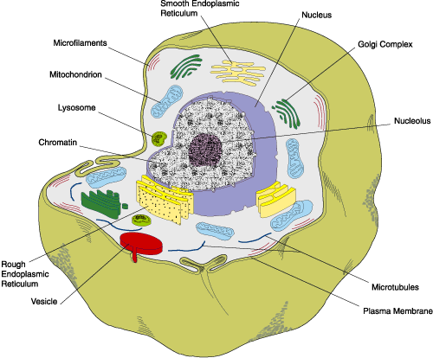
Cell Cartoon
Number of genes encoding different proteins in a typical human cell ~ 30,000
Number of different proteins expressed in a typical human cell ~ 2,000
Number of protein molecules in a typical human cell
~ 100,000,000

Slide 5
Cellular processes depend on Signalling Networks and these are based on Protein-Protein Interactions (PPIs)
Many medicines exert their effect by interrupting or enhancing PPIs
Discussed here: ( www.poppi.website )
+
+
+
X

Slide 6
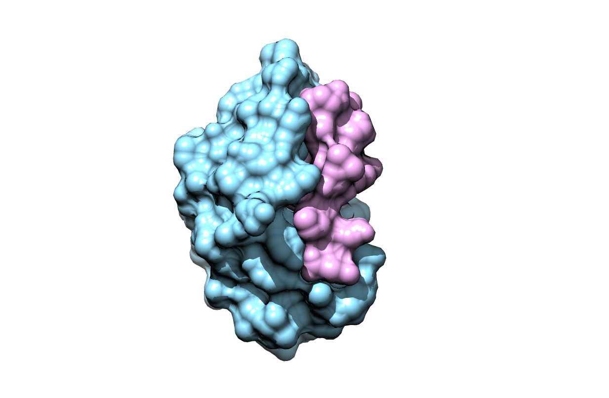
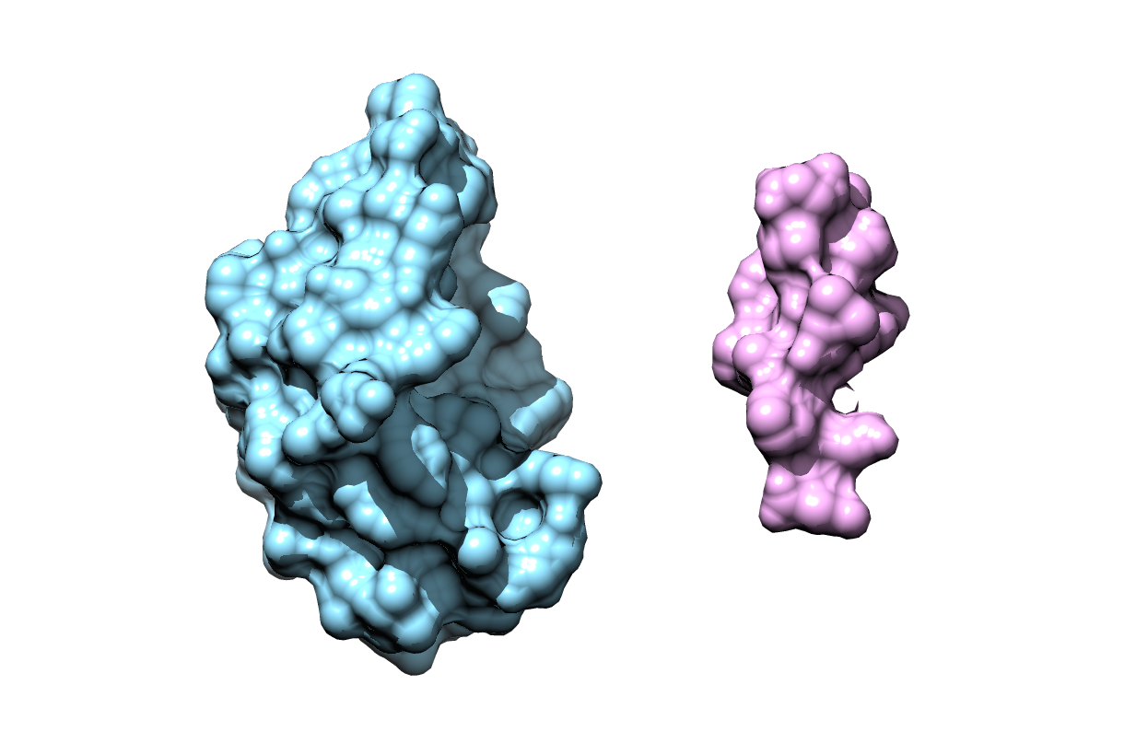
Understanding and predicting how proteins can interact with each other is vital, both for unpicking life processes in the cell and for the design and development of new drugs.

Slide 7
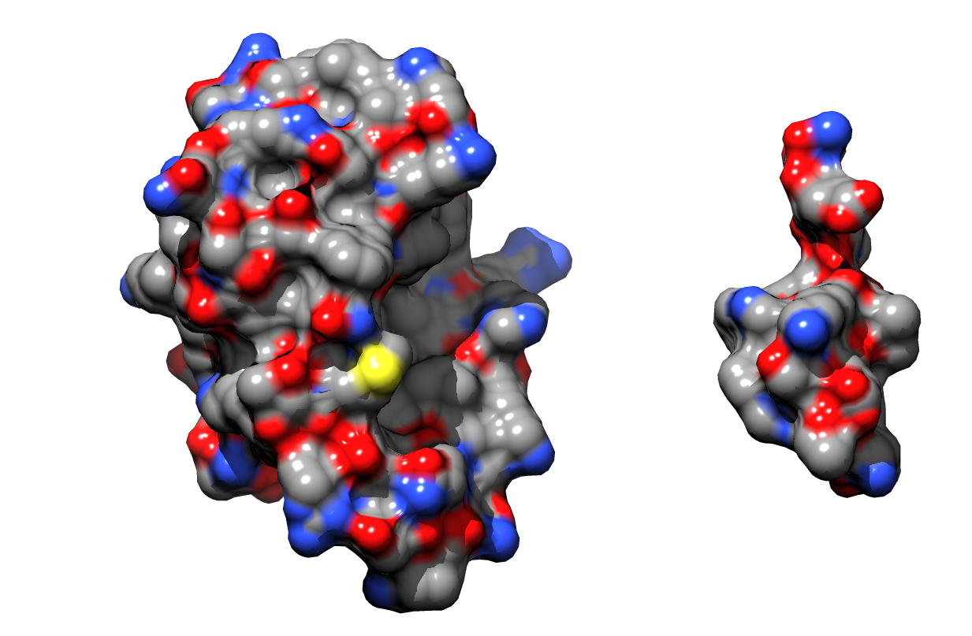
Colour by chemical property

Slide 8
The Game plan
Proposal is to make a 3D assembly game where a user is presented with a pair or a set of individual proteins and the aim is to assemble these into the correct complexes.

Slide 9
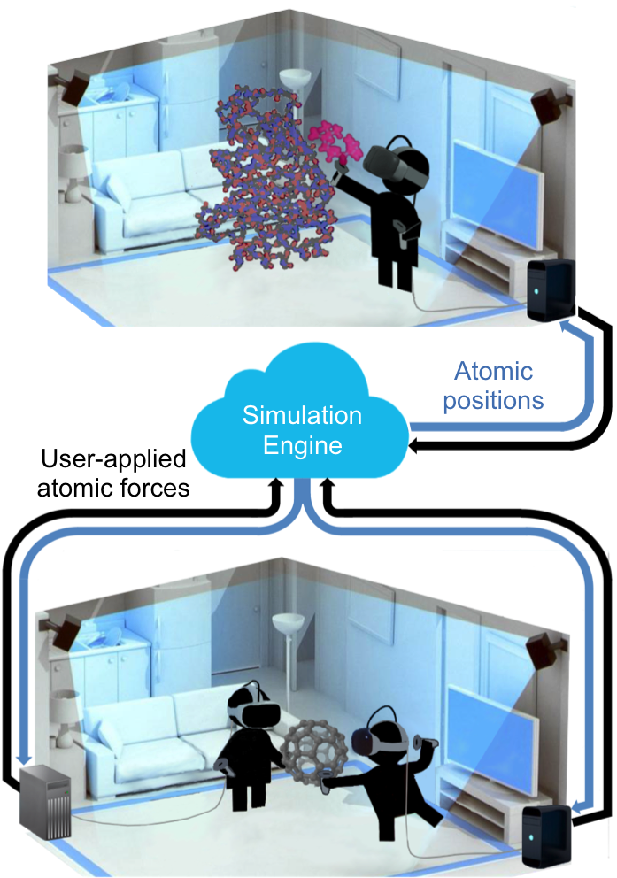
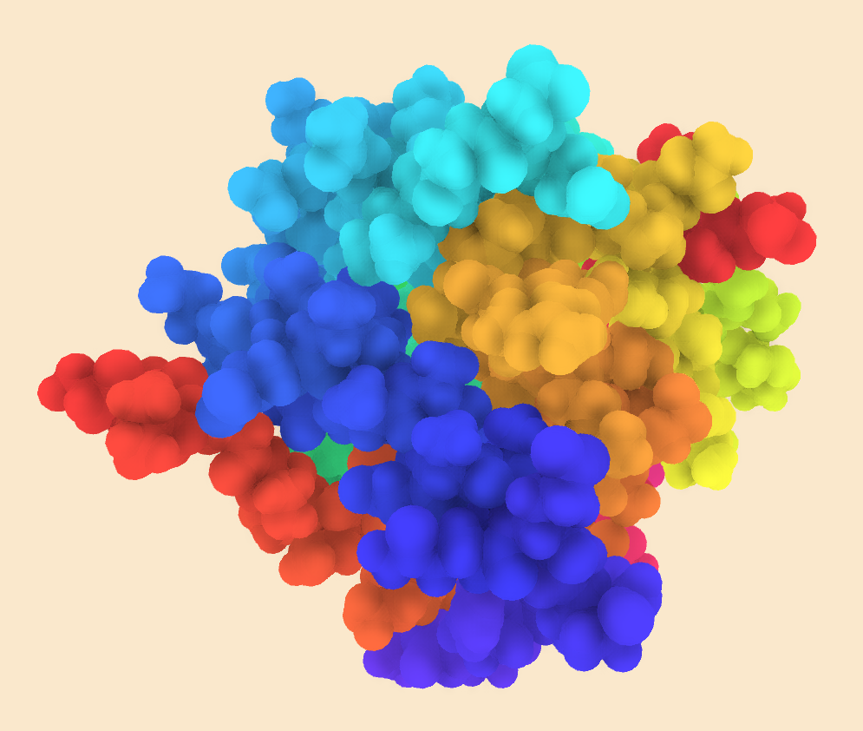
Glowacki group in Chemistry and NanoSimBox
( www.nanosimbox.com )

Slide 10
Expertise
Glowacki - VR and computational chemistry
Woolfson - Protein design and experiments
Sessions - Protein docking and energetics
Funding
PoPPI
ISAMBARD-VR
BUDE

Slide 11
What We Need
Your expertise to bring these strands together to make a VR docking “game”
Together – what can we deliver
PES
Data for machine learning approaches to P-P docking

Slide 13
+
+
+

