Slide 1
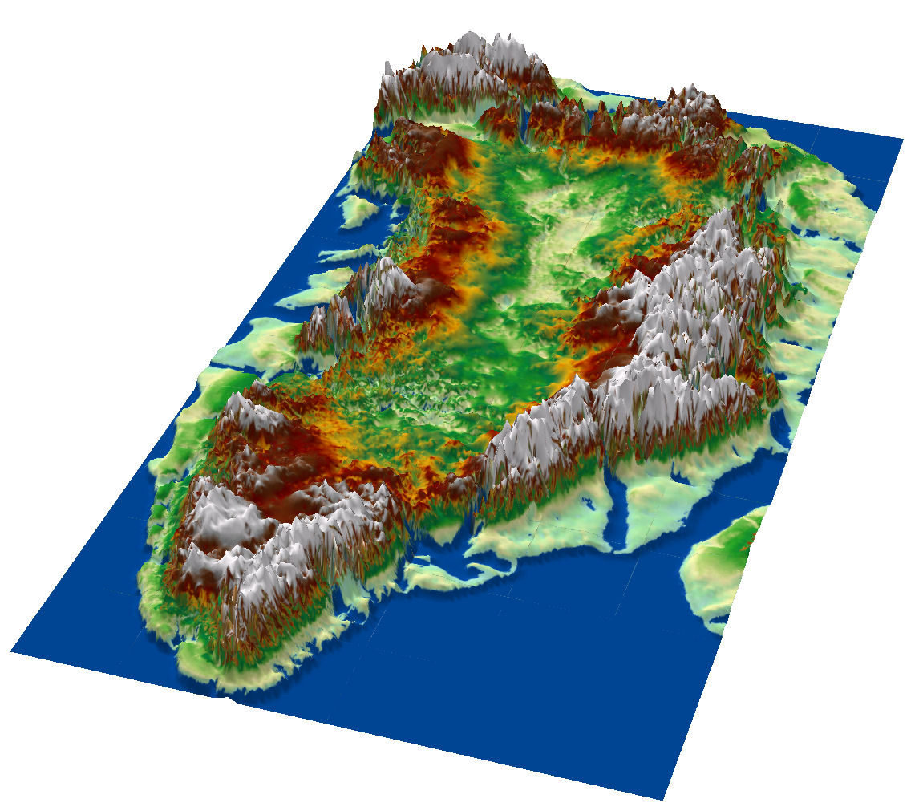
Basal Properties of Greenland
Jonathan Bamber and Michael Cooper
School of Geographical Sciences
j.bamber@bristol.ac.uk

Slide 2
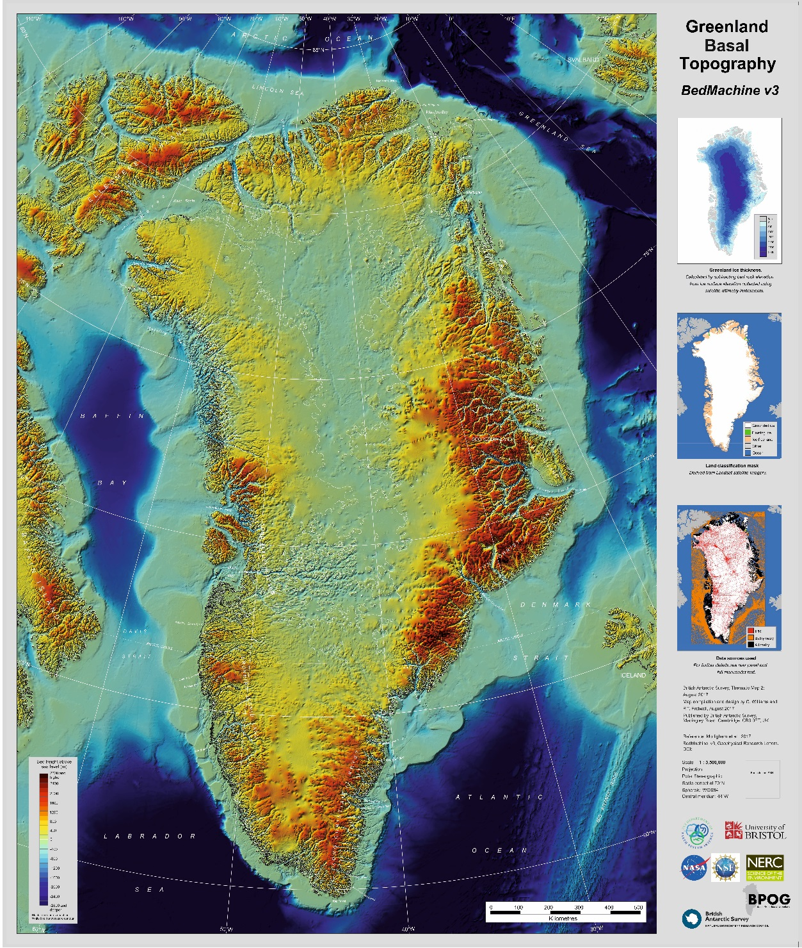
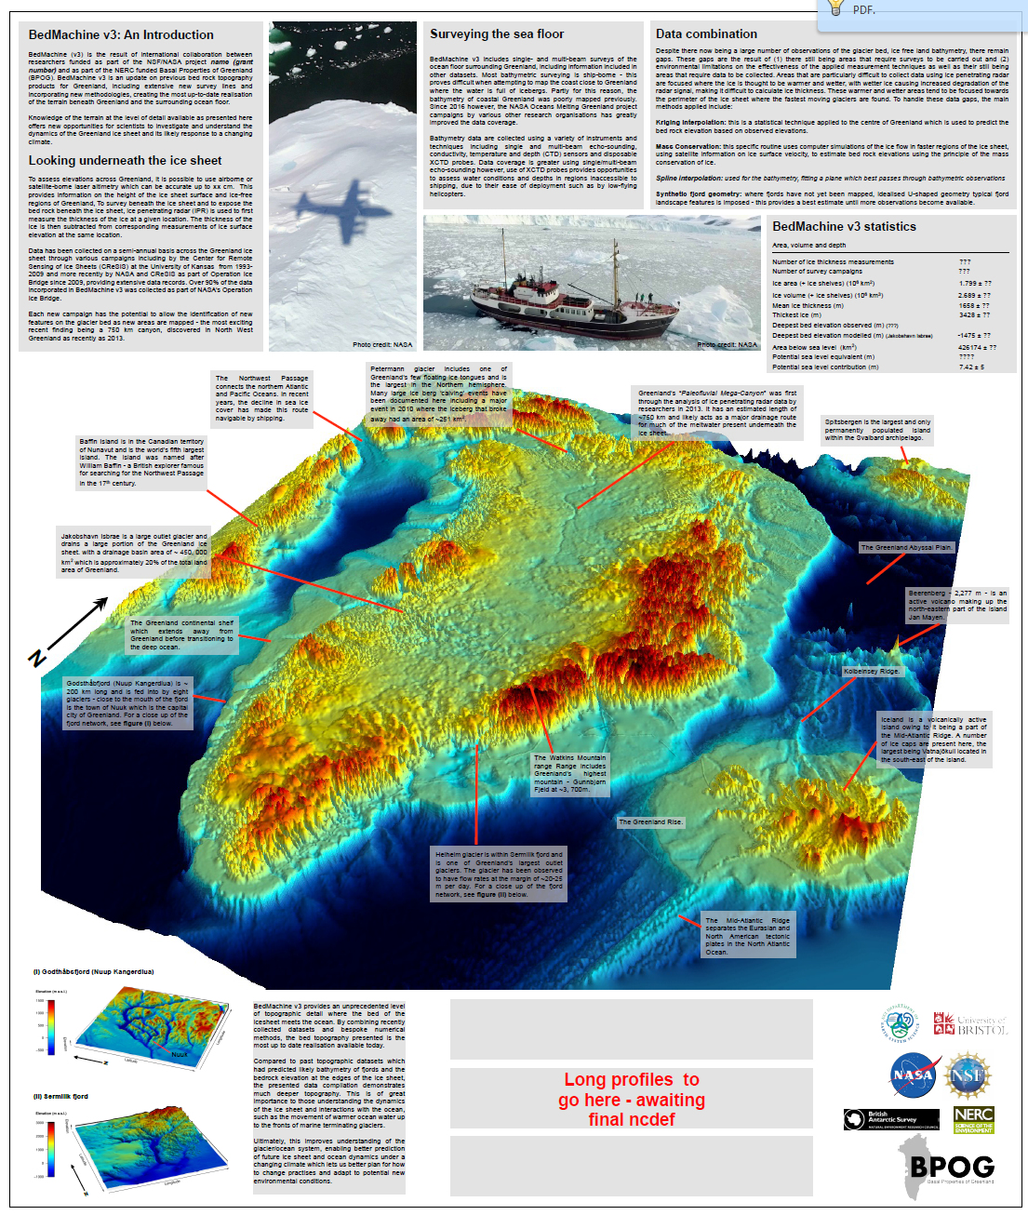

Slide 3
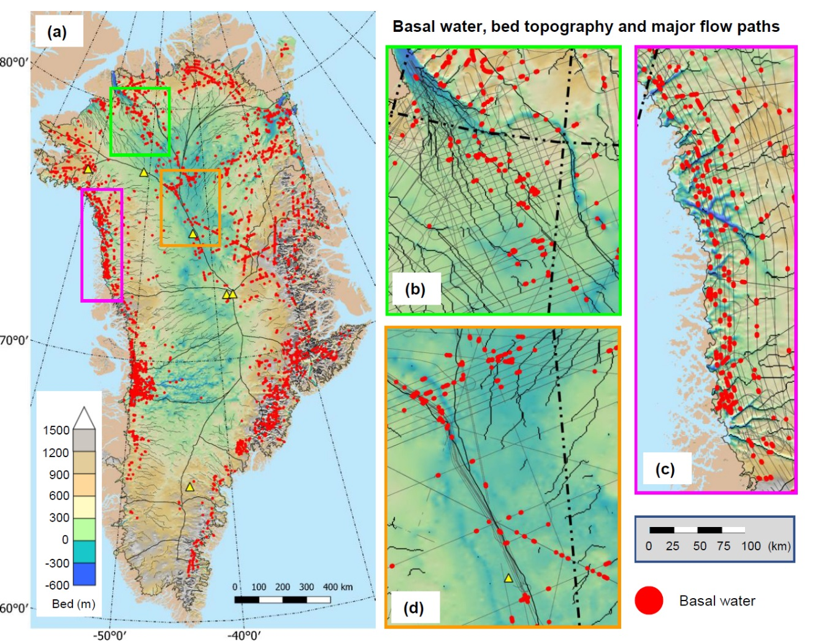
Other layers of info...

Slide 4
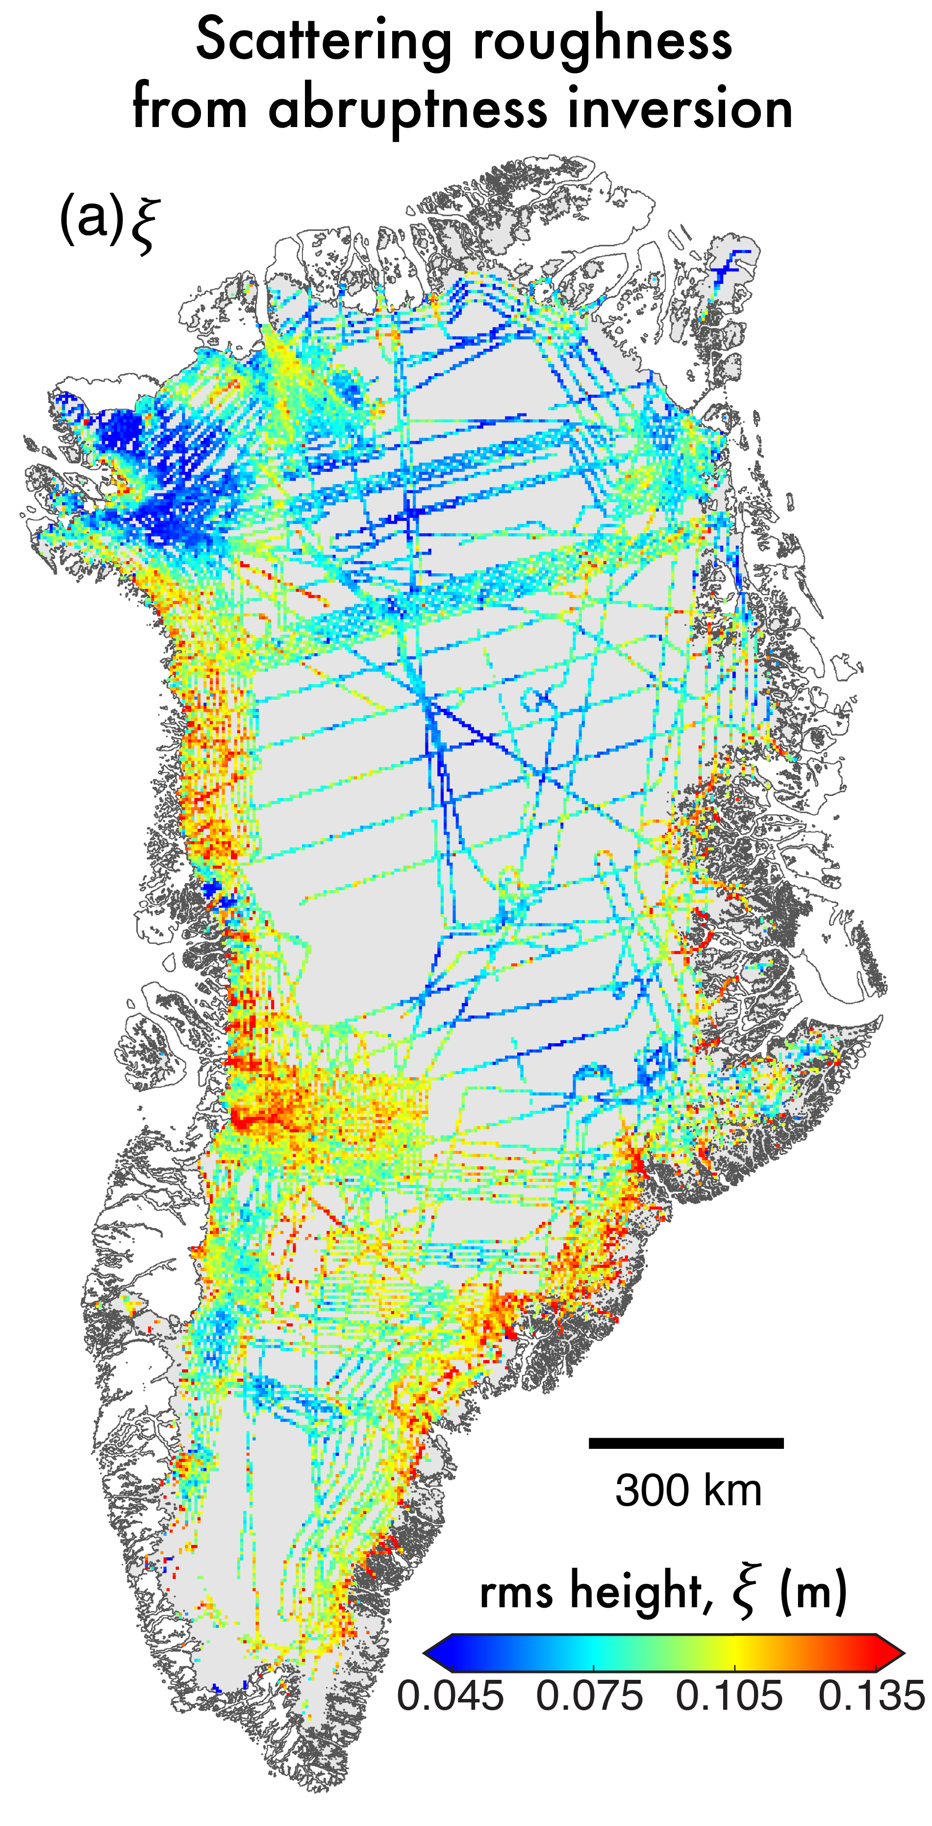
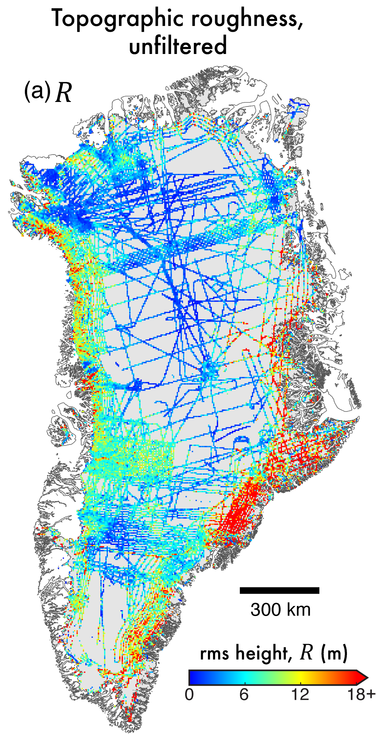
Mapping scattering-derived roughness
Broadly similar spatial relationship to topographic roughness, despite scale-change – however, key differences.
Isotropic measure – cannot filter with velocity direction as with topographic roughness.
Notes:
So why Greenland?
Greenland is currently experiencing an increased mass loss in conjunction with contemporary climatic warming -- with much of this mass being lost through the acceleration in outlet glaciers.
Current estimates suggest that the GrIS is contributing 0.8 mm per year to global sea level rise, and has the potential to contribute 7.36 m if it were to melt completely.
So what is radioglaciology? And why use it?
In order to improve the understanding of dynamic response of ice sheets to future climatic perturbation, increased effort has been made to elucidate the bed elevation and ice thickness of ice sheets by airborne geophysical survey, using ice penetrating radar (or radio-echo-sounding) -- parameters which constrain numerical modelling to project future change.
Airborne radar transmitters record information by flying over the ice sheet, and measuring reflection strength, and response time. Allowing the visualisation of the ice's surface, bed as well as englacial stratigraphy.
There is a wealth of data in the gathered product to look further into both englacial, and subglacial characteristics, which are not only fundamental in influencing ice sheet dynamics, flow variability and outlet glacier behaviour, but can also provide much more information.

Slide 5
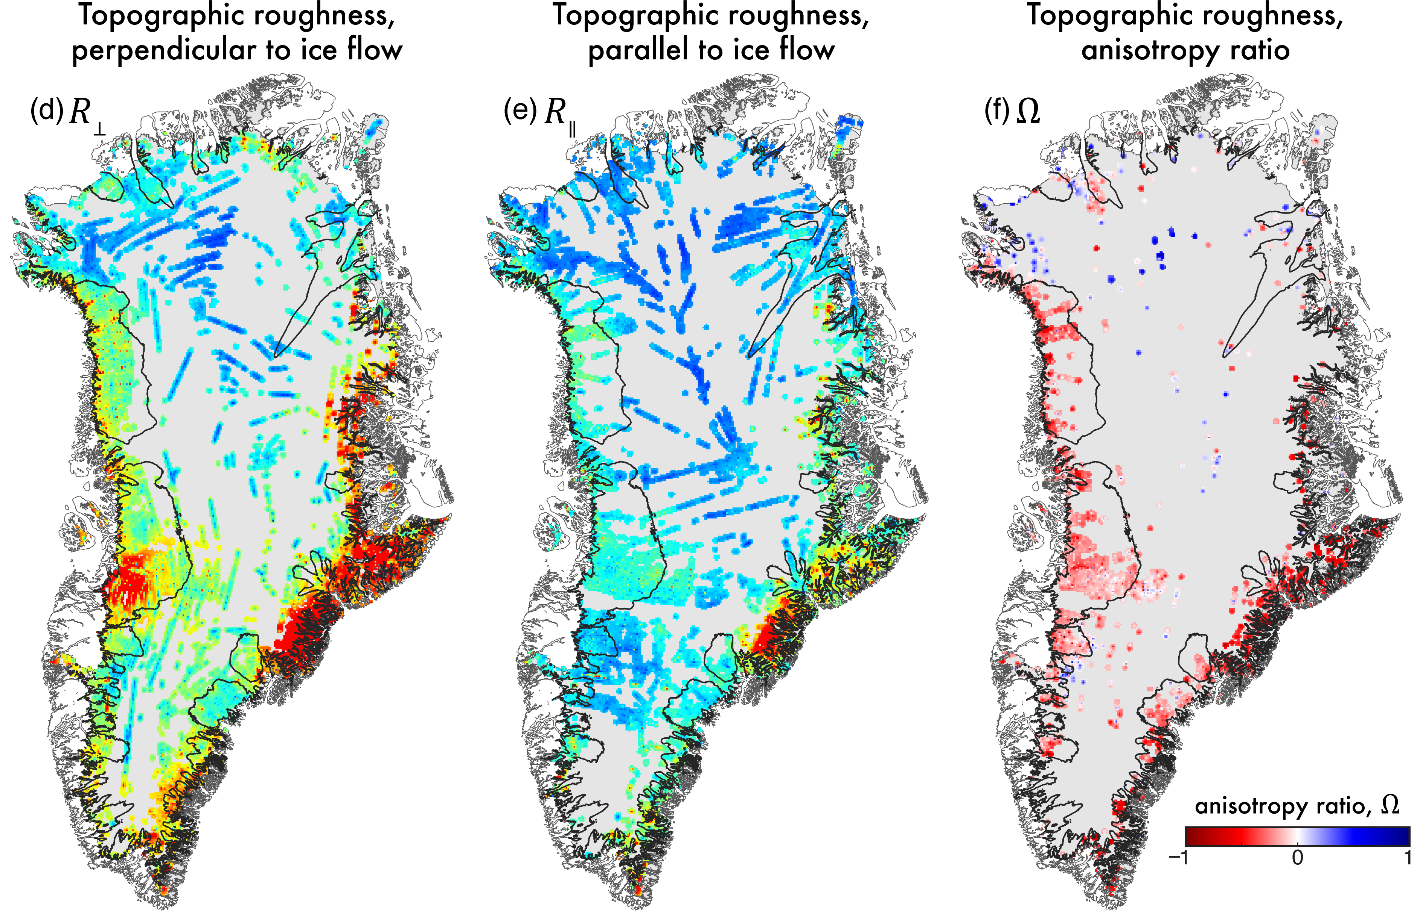
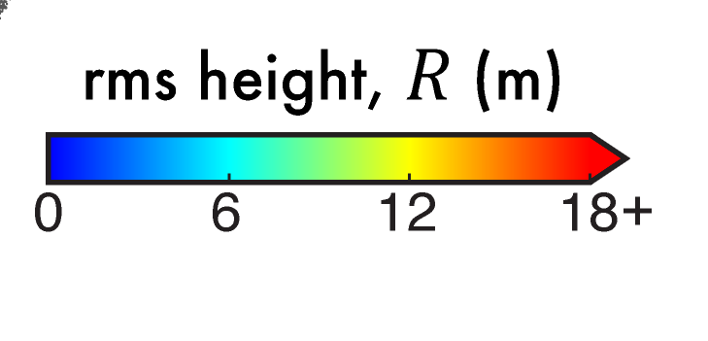
Mapping topographic roughness
Notes:
So why Greenland?
Greenland is currently experiencing an increased mass loss in conjunction with contemporary climatic warming -- with much of this mass being lost through the acceleration in outlet glaciers.
Current estimates suggest that the GrIS is contributing 0.8 mm per year to global sea level rise, and has the potential to contribute 7.36 m if it were to melt completely.
So what is radioglaciology? And why use it?
In order to improve the understanding of dynamic response of ice sheets to future climatic perturbation, increased effort has been made to elucidate the bed elevation and ice thickness of ice sheets by airborne geophysical survey, using ice penetrating radar (or radio-echo-sounding) -- parameters which constrain numerical modelling to project future change.
Airborne radar transmitters record information by flying over the ice sheet, and measuring reflection strength, and response time. Allowing the visualisation of the ice's surface, bed as well as englacial stratigraphy.
There is a wealth of data in the gathered product to look further into both englacial, and subglacial characteristics, which are not only fundamental in influencing ice sheet dynamics, flow variability and outlet glacier behaviour, but can also provide much more information.

Slide 6
http://www.bbc.co.uk/news/science-environment-42260580
animation4.mp4
canale_grande_V05_p30_1080.mp4

